Slide 1
Welcome to the
Annual Employers Meeting
Councillor Richard Rout
Chairman of the Pension Board

Slide 2
Suffolk Pension Board
Current board members are:
Three Employer reps
Cllr Richard Rout, Representing Suffolk County Council
Ian Blofield, Representing other local tax raising bodies
Thomas Jarrett, Representing all other employers
Three Scheme Member reps
Kay Davidson, Representing active scheme members
Richard Blackwell, Representing retired members
Pauline Bacon, Representing the unions
The Board meets four times a year
Notes:
……. to assist Suffolk County Council as administering authority of the Suffolk Pension Fund in ensuring the effective and efficient governance and administration of the Suffolk Pension Fund in line with legislative requirements.

Slide 3
Today’s Agenda
Introduction from Councillor Karen Soons, Chairman of the Suffolk Pension Fund Committee
Investment Markets Economic Update – Peter Richie, Waystone
Pension Fund Update - Paul Finbow, Head of Pensions, covering: -
  Investment Performance of the Fund
  Key issues for the Pension Fund Committee
Actuary Update – Craig Alexander, Hymans Robertson, covering Current Funding Level
Open Forum
  Open session to raise additional questions
Closing Remarks by Councillor Richard Rout, Chairman of the Suffolk Pension Fund Board

Slide 4
Introduction
Councillor Karen Soons
Chairman of the Pension Fund Committee

Slide 5
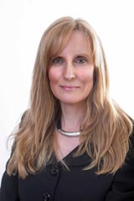
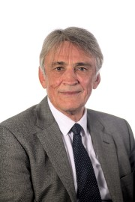
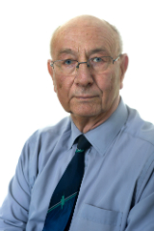
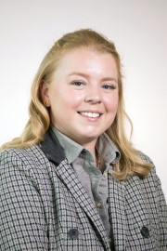
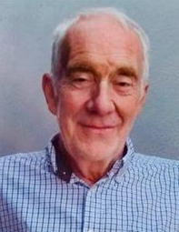
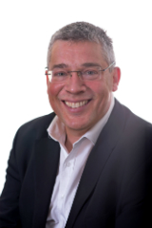
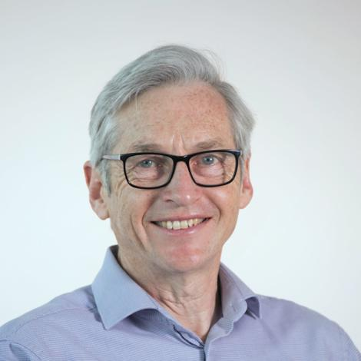
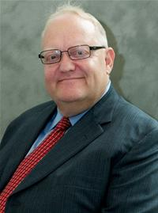
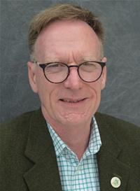

Suffolk Pension Fund Committee Members
Karen Soons
Chairman
Edward Back
David Goldsmith
Georgia Hall
David Nettleton
Robert Lindsay
Simon Harley
District
Representatives
Union
Representative
Colin Kreidewolf
Simon Dowling
Steve Warner
Notes:
I was appointed to the Board in May 2017 and became Chairman in October 2019.
7 County Councillors appointed representing the political make up of Suffolk County Council.
2 District Councillors and Union Rep
Responsible for making all the key decisions on Investments and Funding – meets six times a year

Slide 6
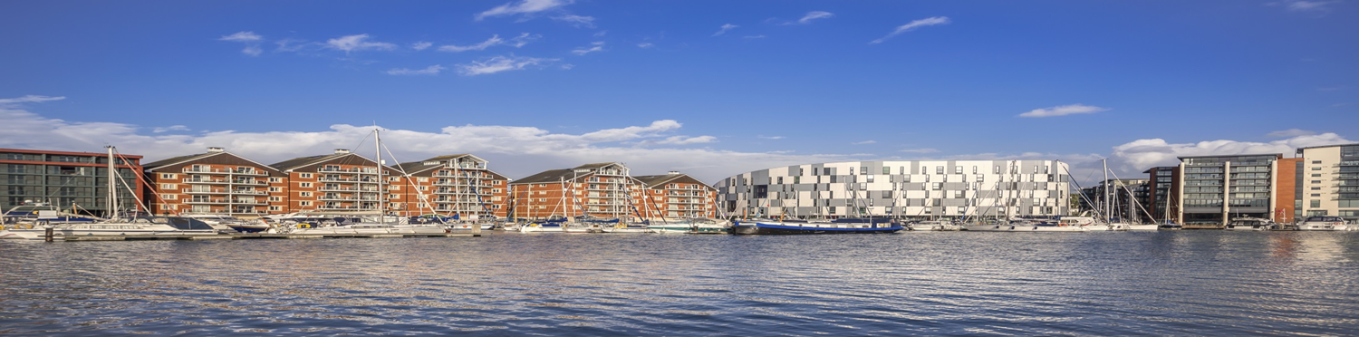
Pension Fund Update
Paul Finbow – Head of Pensions

Slide 7

Update will Cover
  Fund Value and Returns
  Investments
  Committee Considerations
  Admin Developments

Slide 8

Trend in Fund Value
Notes:
3.756bn 2021/22
3.759bn 2022/23
3.876bn Sept 23
4.007bn Today

Slide 9
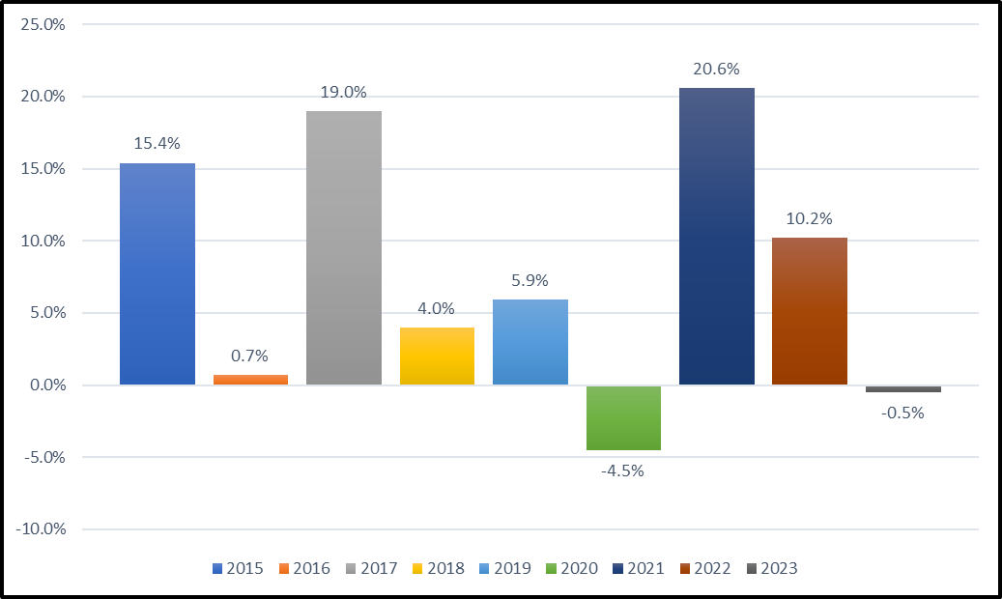
Performance Returns
Notes:
2010/11 8.1%
2011/12 2.0%
2012/13 13.6%
2013/14 5.6%
2014/15 15.4%
2015/16 0.7%
2016/17 19%
2017/18 4%
2018/19 5.9%
2019/20 -4.5%
2020/21 20.6
2021/22 10.2
2022/23 -0.5%
Up 6% so far this year

Slide 10
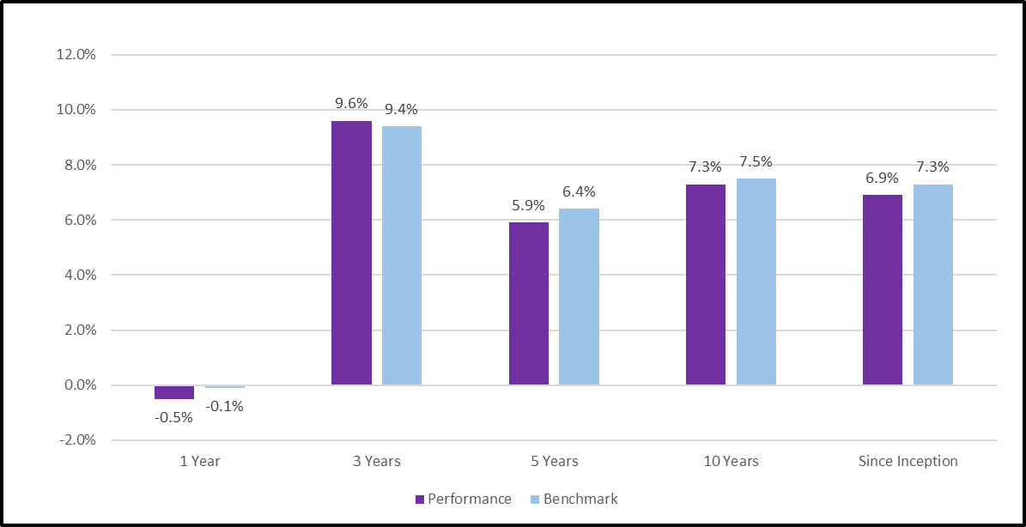
Performance Returns 2022-23
Notes:
This slide

Slide 11

Suffolk’s Strategic Asset Allocation
Notes:
Recent changes – Introduction of Low Carbon Index Fund
- Active mandate for Emerging Markets
- New Bond Mandate with Janus Henderson
- Extra 2% allocated to Bonds

Slide 12
Committee Considerations
  High inflation on Pensions in payment
  High Funding level – Future effect on employers' contributions
  Investment income needed to pay Benefits – Cashflow Negative
  Further investments through pool – Property and other Alternatives
  Government Revised Pooling Guidance
  Net Zero Commitment – 2050 or earlier
  UK Stewardship Code Application – Spring / Autumn 2024
  Governance changes – The Pensions Regulator and Scheme Advisory Board
Notes:
10.1 % plus 6.7% CPI inflation
78% pooled at present – Further 10% likely in 2024/25
10% Private Equity and 5% Leveling Up

Slide 13
Other Administration Developments
  Implementation of the McCloud Remedy
  I connect – All employers submitting Monthly data by 31 March 2025
  New AVC Provider – Legal and General

Slide 14

Any Questions ?

