Slide 1
Suffolk Pension Fund
January 2024
Peter Ritchie
Head of Investment Oversight, Waystone Management UK

Slide 2
Agenda
1 | Inflation
2 | Central Bank Rates
3 | Impact on Growth
4 | Asset Returns
5 | China
6 | Sustainable Investing
7 | ACCESS Fund Returns

Slide 3
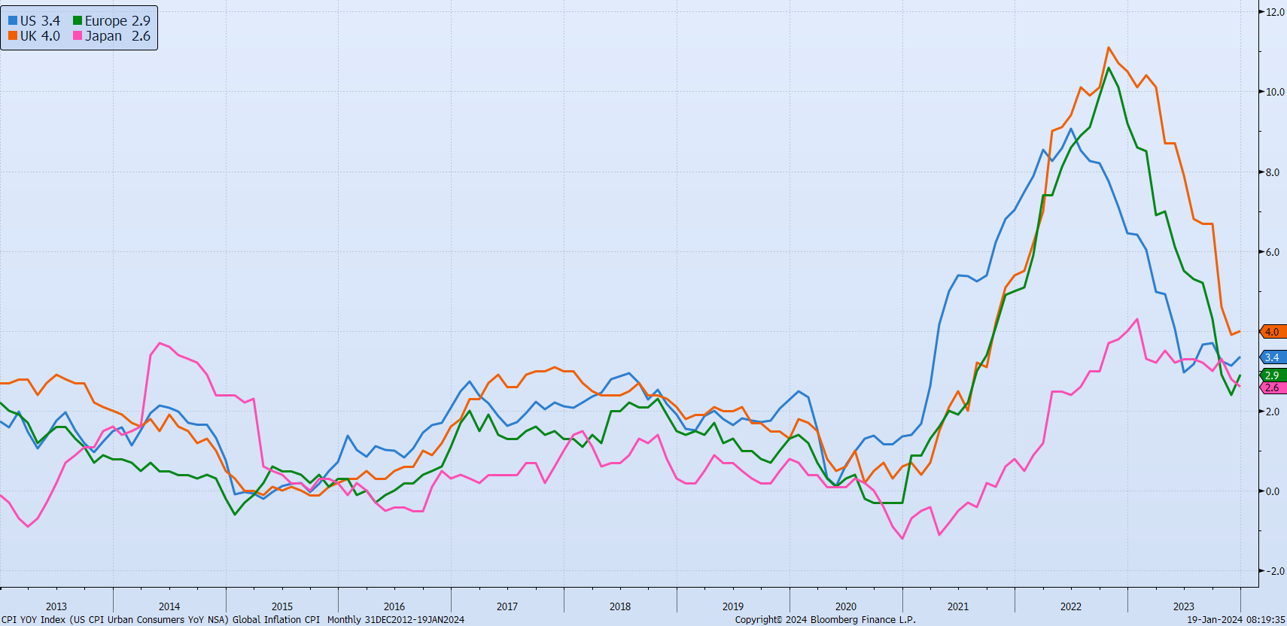
Inflation Shock
Inflation evolution for key markets

Slide 4
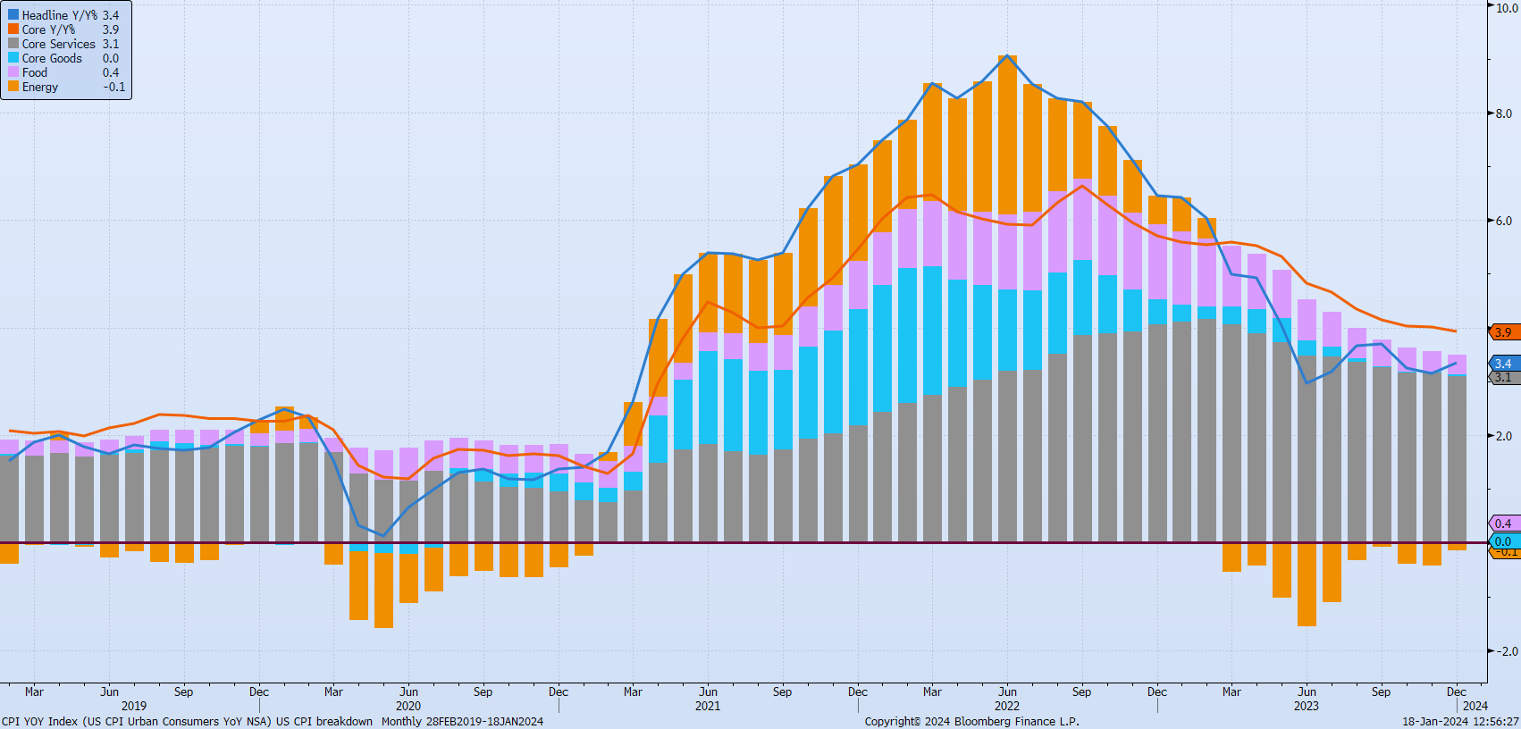
US Inflation Components
Contribution to US Inflation from key drivers

Slide 5
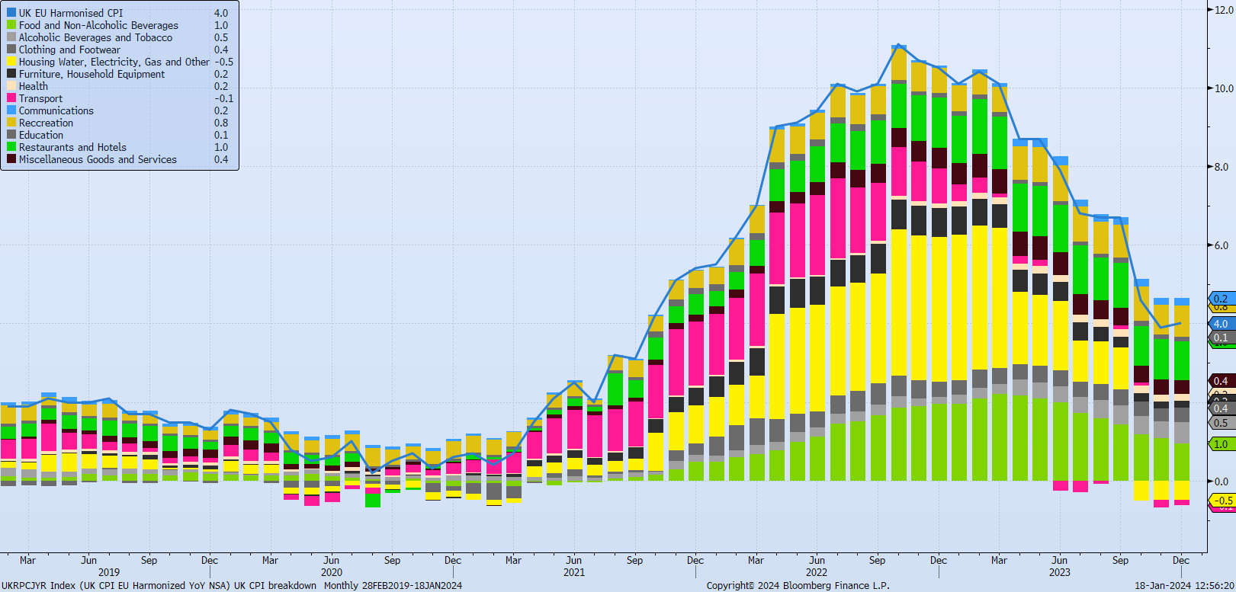
UK Inflation Components
Contribution to UK Inflation from key drivers

Slide 6
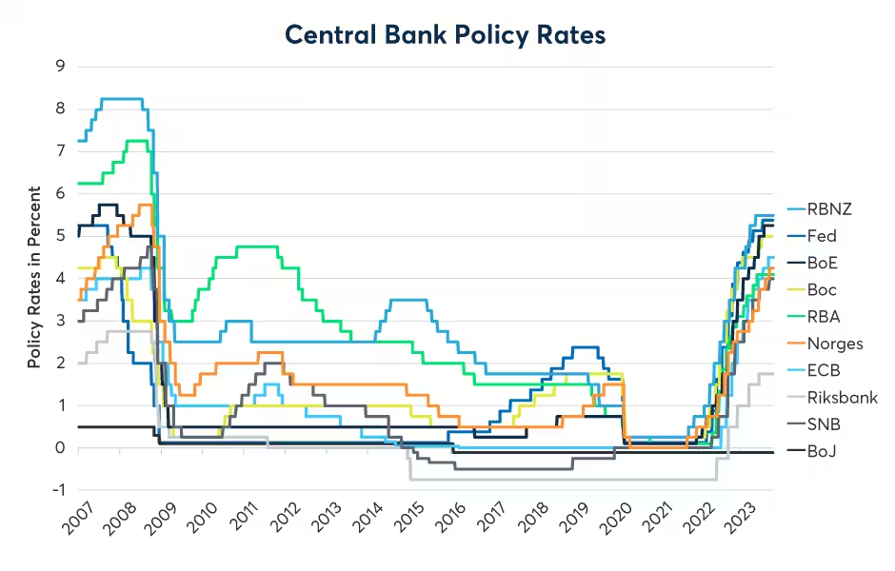
Rapid Rise in Central Bank Rates
Central Bank Policy Rate Changes
Source: CME

Slide 7
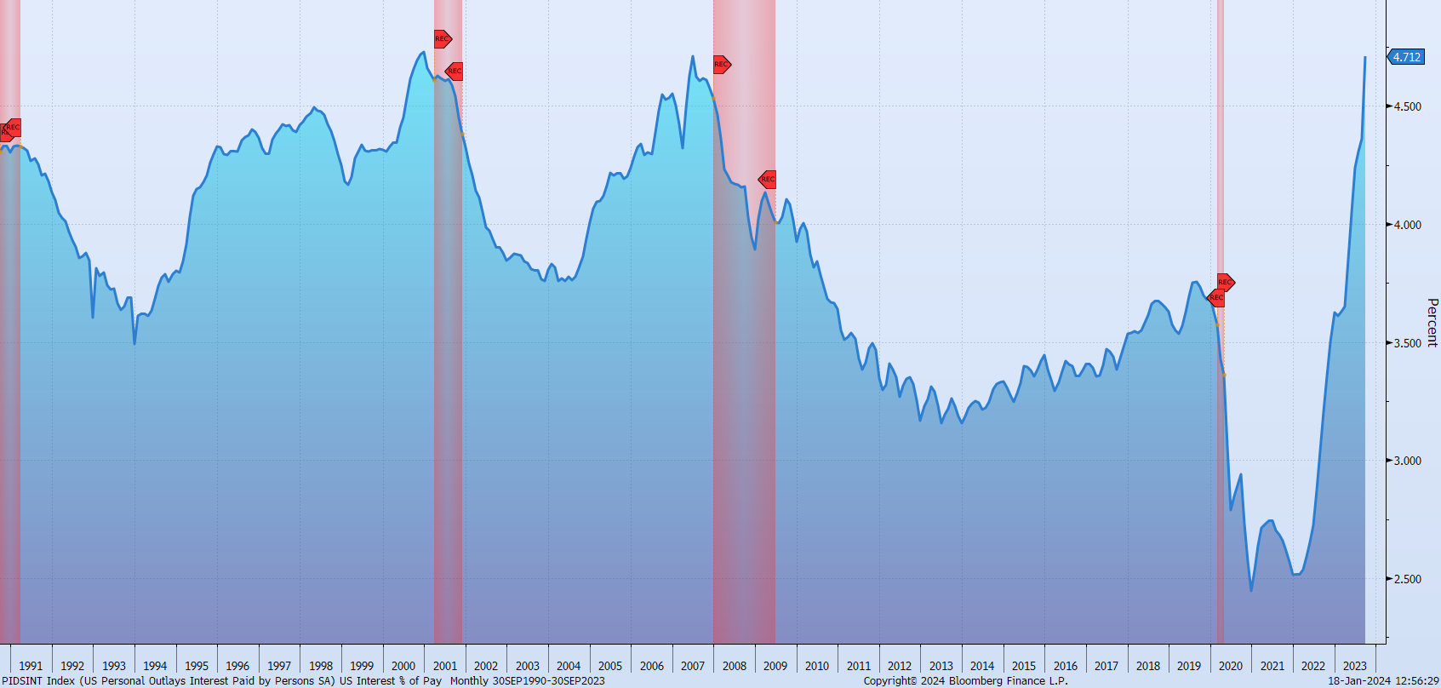
Rapid Growth In Interest Payments
Personal outlay of interest paid

Slide 8
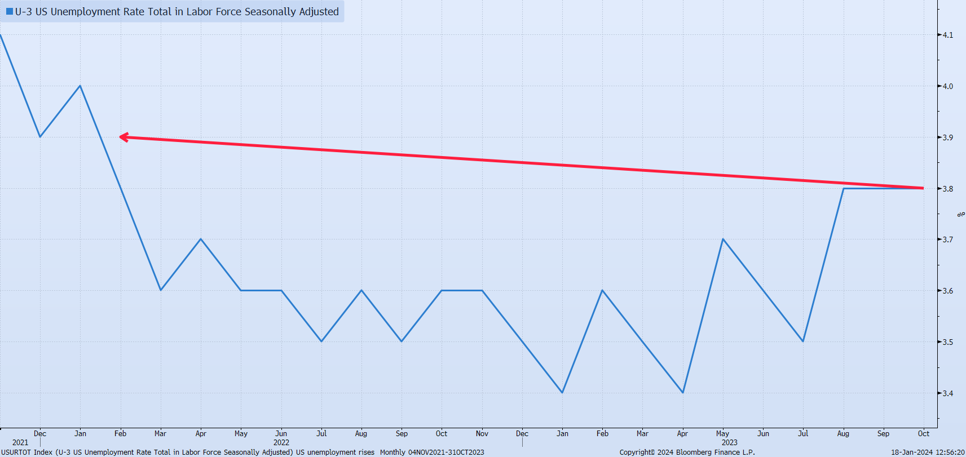
Unemployment Edging Higher
US Unemployment rate

Slide 9
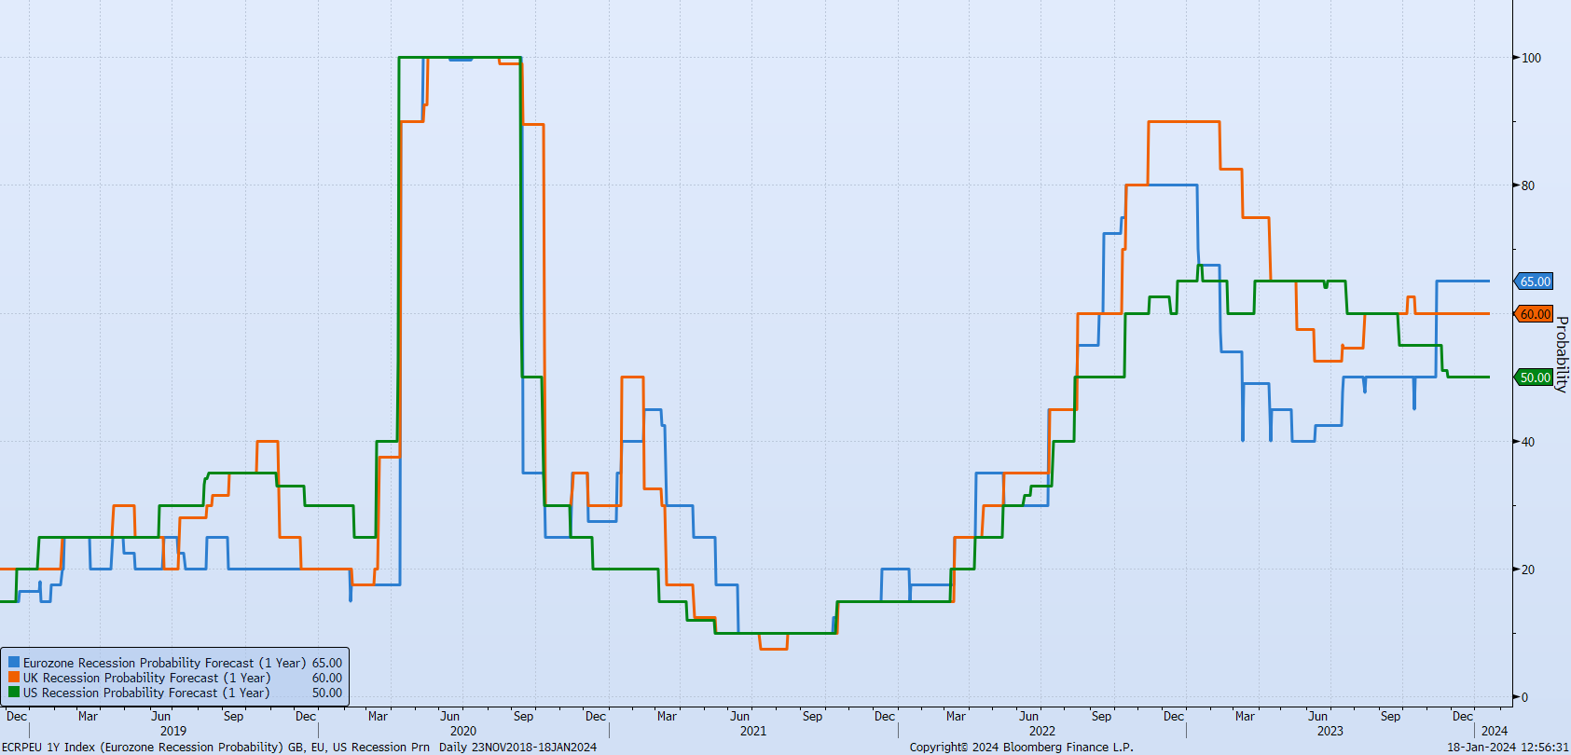
Recession Probability Estimates

Slide 10
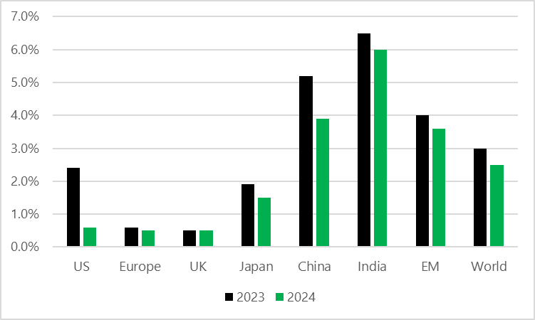
GDP Growth Slowing
GDP forecasts for 2023 & 2024
Source: Amundi Asset Management, Waystone Management UK

Slide 11
Positive Equity Returns
Source: MSCI, Bloomberg

Slide 12
Credit Market Turning Point?
Source: FTSE, Bloomberg

Slide 13
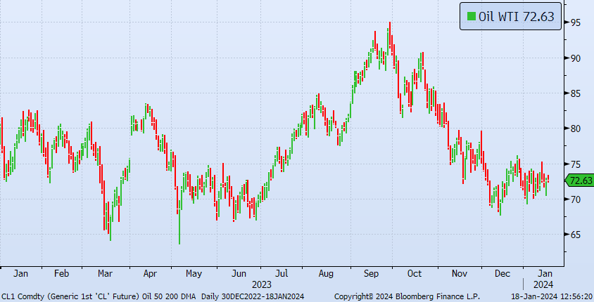
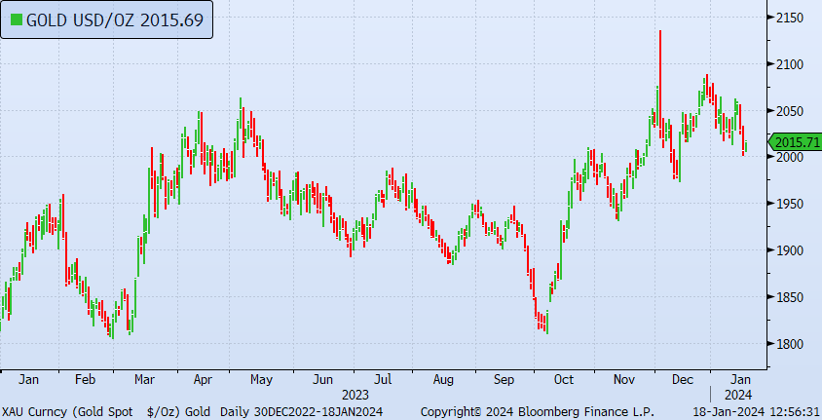
Commodity Returns
Source: Bloomberg

Slide 14
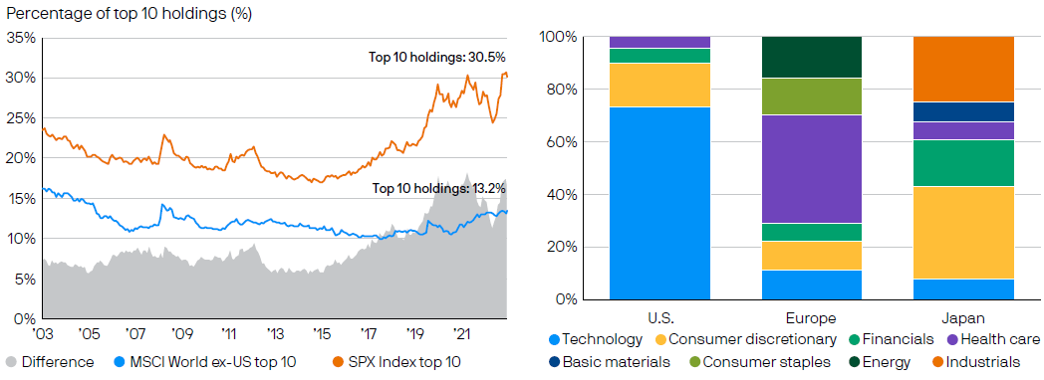
Index Concentration is Extreme
Relative concentration of Indices and their sectoral composition
Source: J.P. Morgan Asset Management

Slide 15
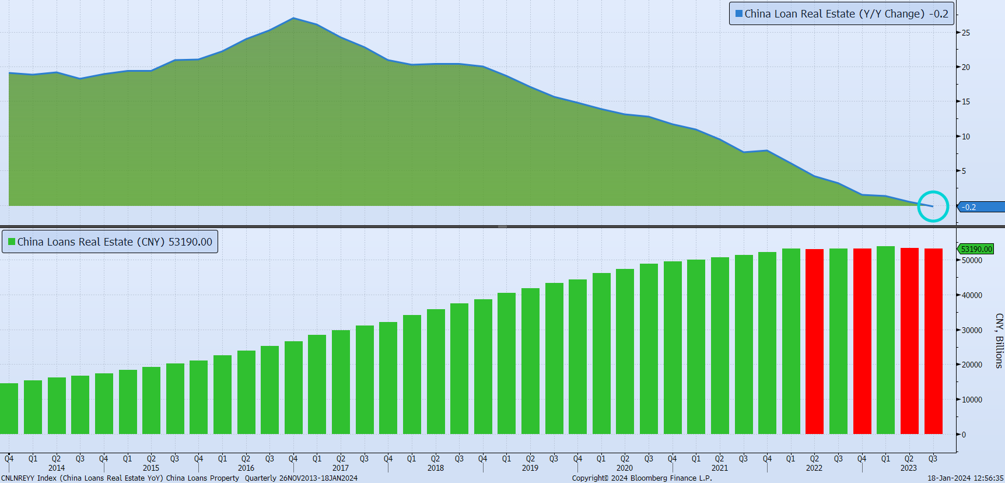
Applying the Brakes to China’s Real Estate Sector
China Real Estate loan growth has slowed since 2016, turning negative in 2023.

Slide 16
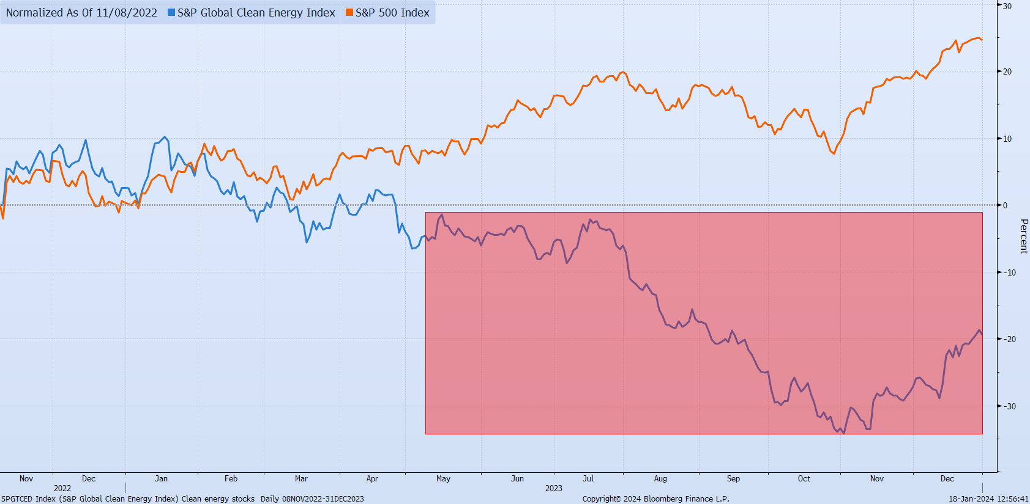
Clean Energy Stock Challenges
Clean Energy stocks have underperformed in 2023

Slide 17
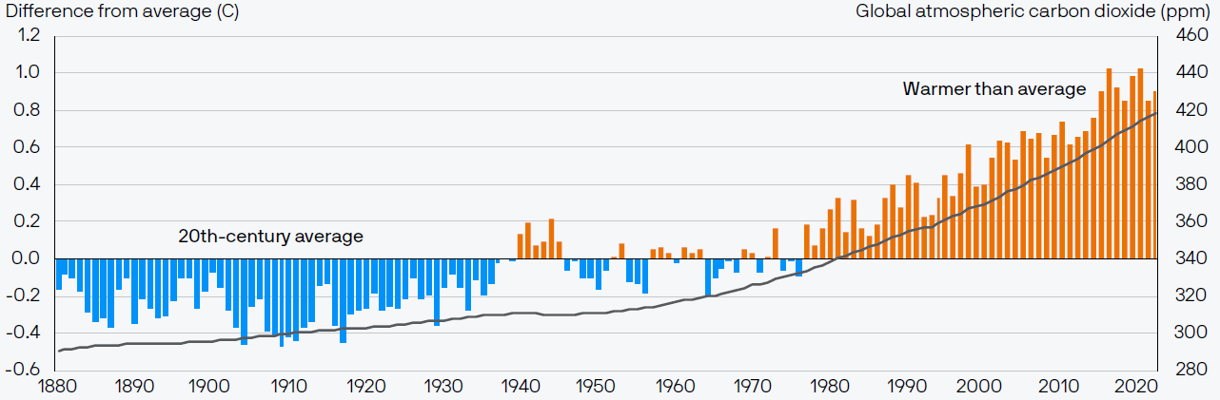
Fundamental Sustainability Challenges Accelerating
Changes in Temperature v 20th century average and atmospheric carbon concentration
Source:J.P. Morgan Asset Management

Slide 18
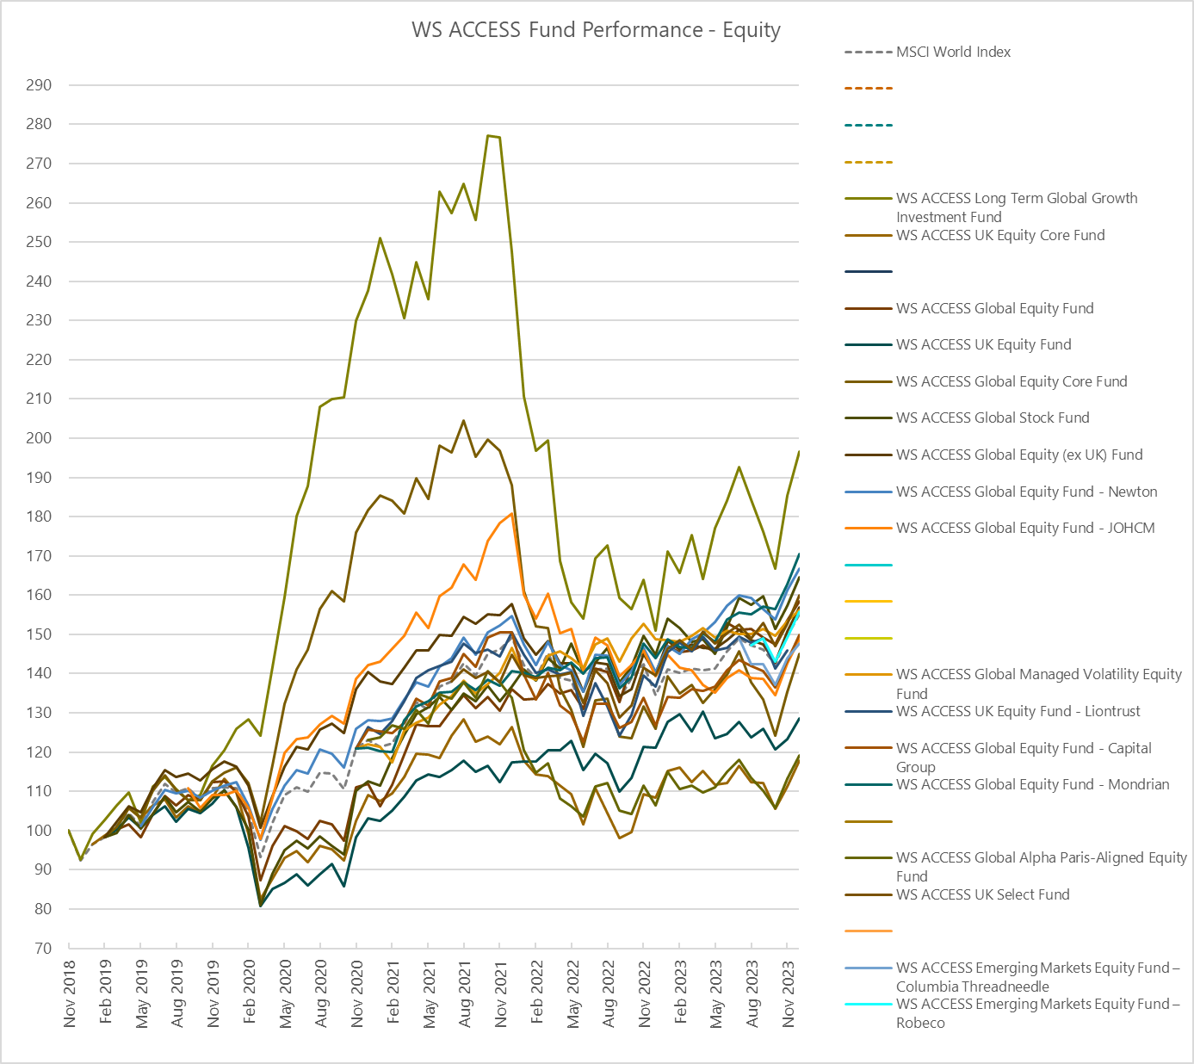
ACCESS Growth Funds
Source: Northern Trust, Waystone Management UK

Slide 19
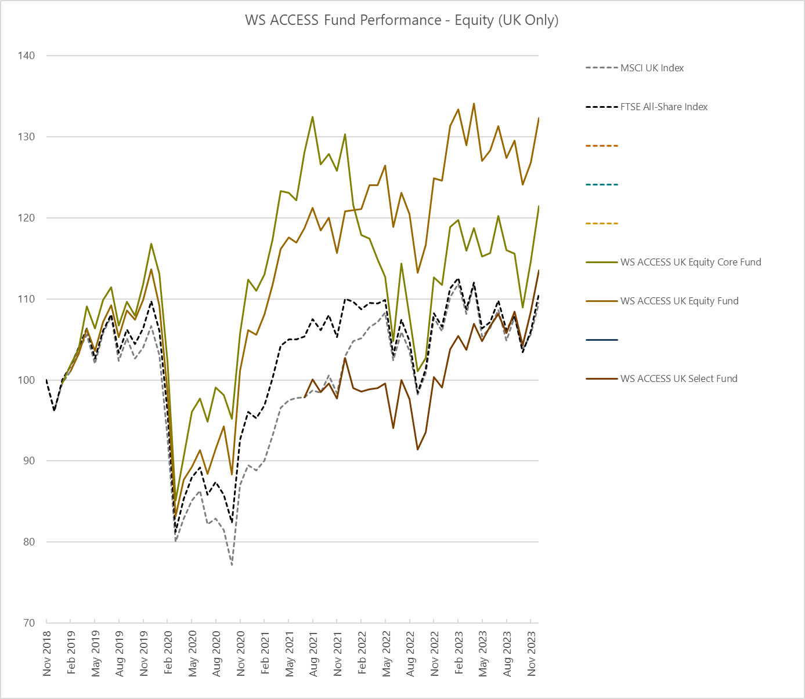
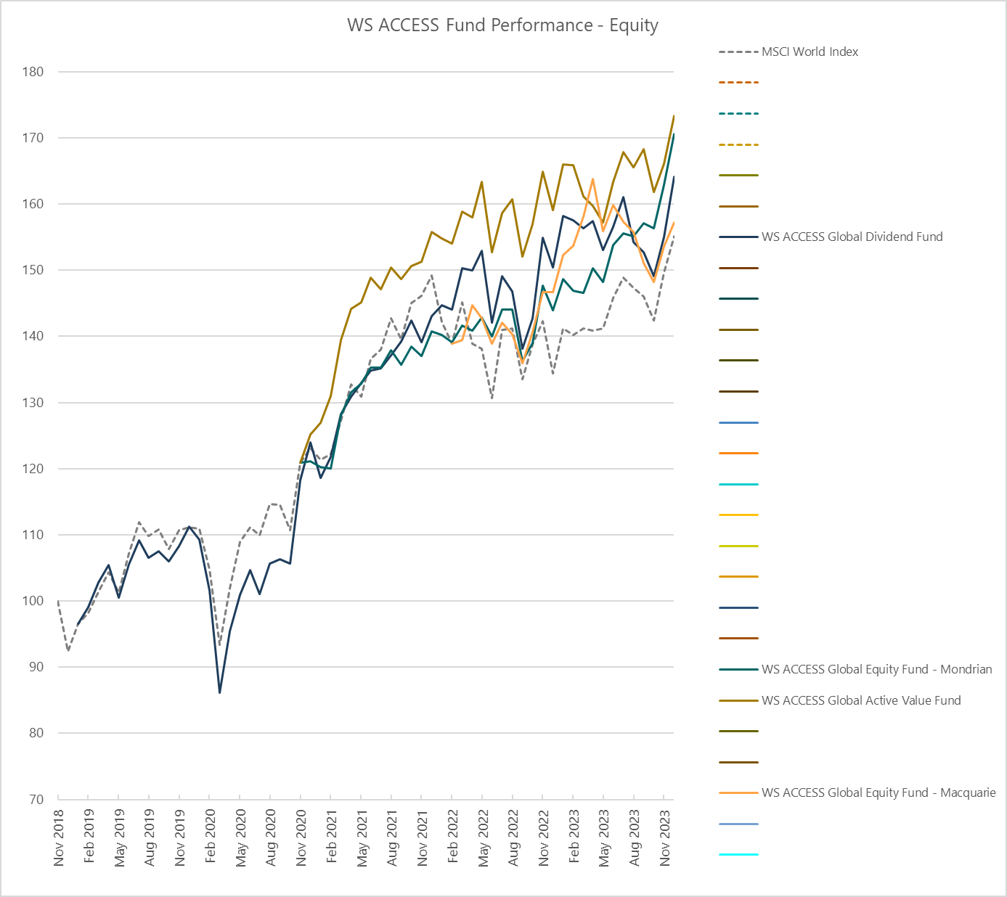
ACCESS Global Value & UK Equity
Source: Northern Trust, Waystone Management UK

Slide 20
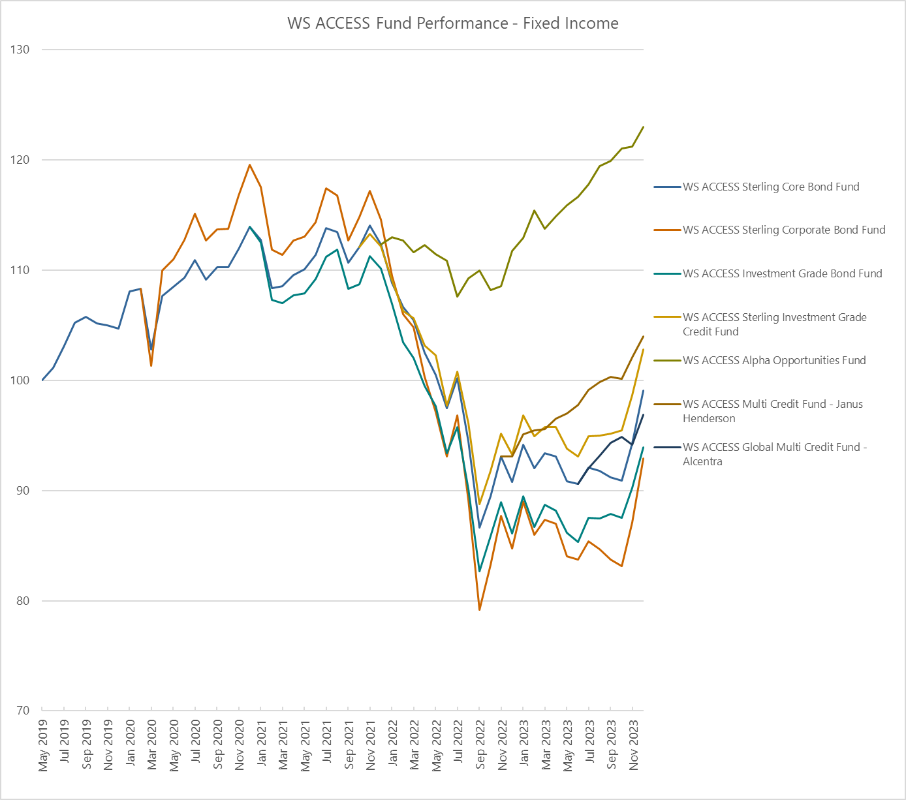
ACCESS Credit Funds
Source: Northern Trust, Waystone Management UK

Slide 21
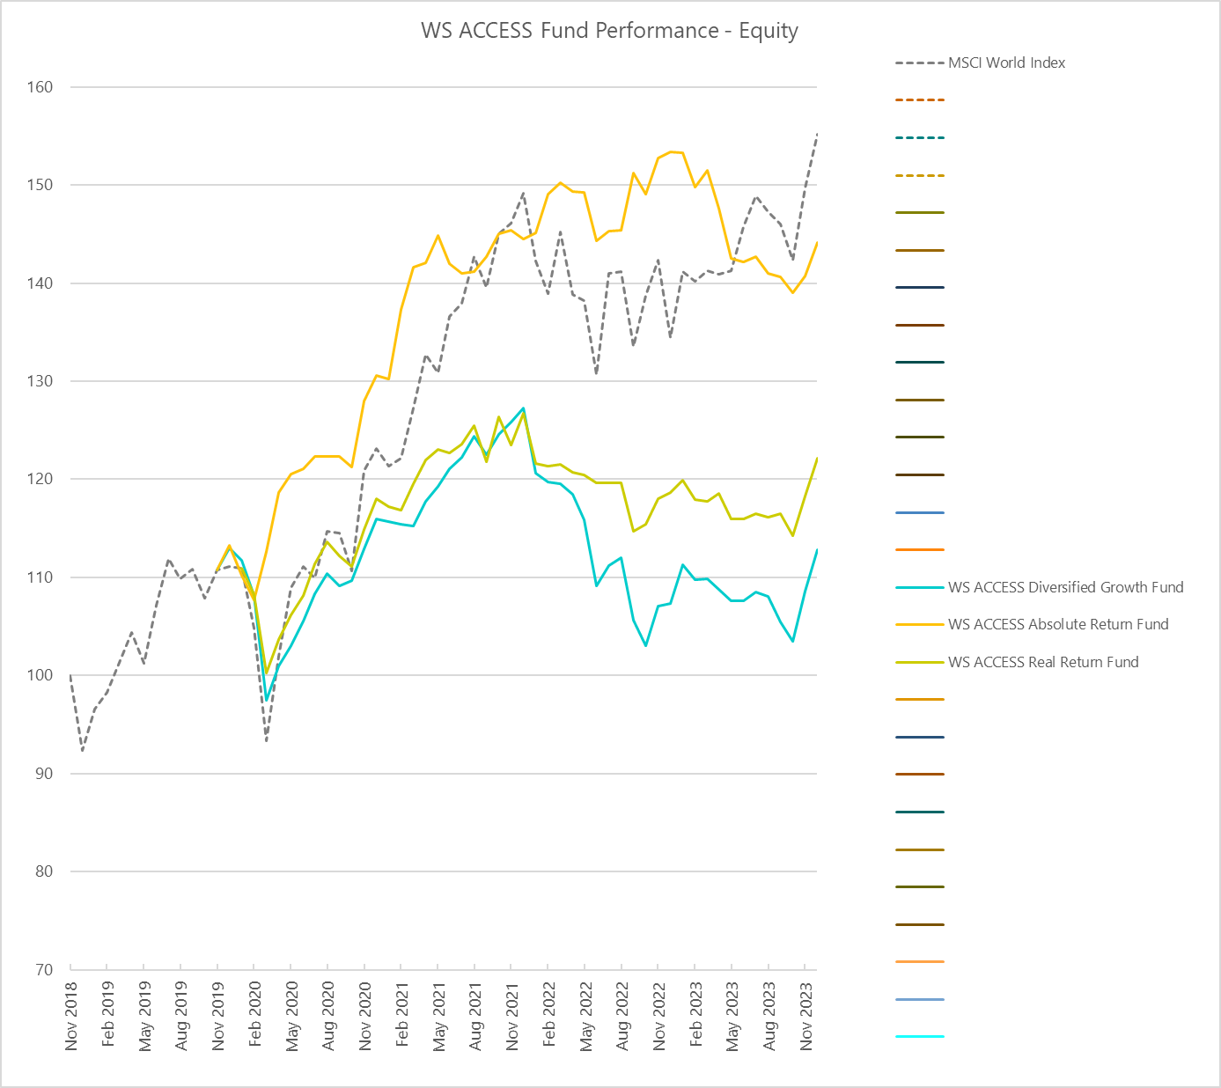
ACCESS Diversified Growth Funds
Source: Northern Trust, Waystone Management UK

Slide 22
Thank you
Peter Ritchie
Head of Investment Oversight
peter.ritchie@linkgroup.co.uk

