Slide 1
Suffolk Pension Fund
Annual Employers Meeting
Actuarial valuation at 31 March 2022
Craig Alexander FFA
07 October 2022
For and on behalf of Hymans Robertson LLP

Slide 2
Contents
Use the menu bar above to navigate to each section.
 | Page
Valuation process | 3
Data and assumptions | 8
Fund-level results | 13
Initial employer results | 17
Next steps | 22
Appendices | 24

Slide 3
The valuation process

Slide 4

The valuation process
Assumptions
advice
Q4 2021/Q1 2022
Contribution rate modelling
Q3 2022/23
Funding Strategy Statement (draft)
Q3 2022/23
Employer discussions
Q4 2022/23
1
2
3
4
5
6
7
8
Data provision
Summer 2022
Initial whole fund results
Q3 2022/23
Employer results
Q4 2022/23
Valuation sign off
31 March 2023

Slide 5
Purpose of whole fund results stage
Whole fund solvency position
High-level health check on funding position at whole Fund level
Risk management
Understand what has caused the funding position to change and the relative magnitude

Slide 6
Individual member valuations
Salary increases, CARE reval
Pension increases
Life expectancy
Lump Sum
Contributions
Expenditure
Member’s Pension
Dependant’s
Pension
Income
40
65
85
Recruitment
Retirement
Death

Slide 7
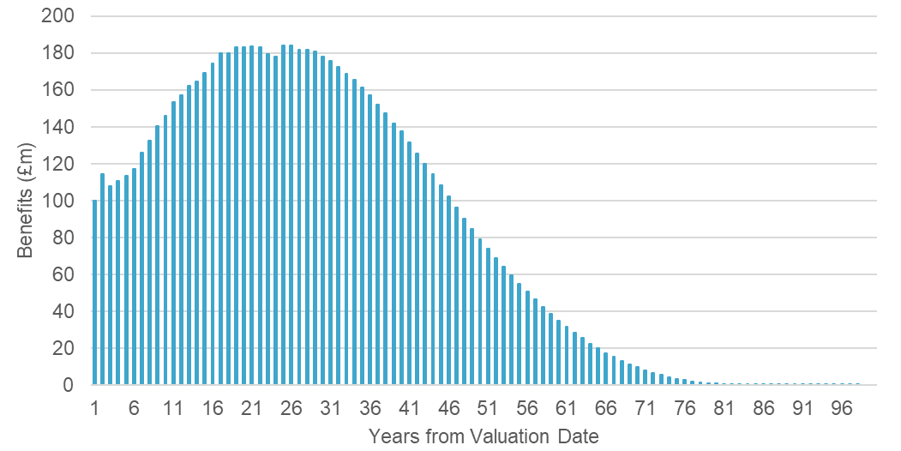
Projected future benefit payments
Combining membership data and the assumptions allows us to project future benefit payments for all benefits accrued up to 31 March 2022.
The projection will be different from the last valuation due to:
Events between 2019 and 2022 which were different from expectations – reflected in the updated membership data.
Estimates of the future which have changed – reflected in the updated assumptions.
The figures in this report are based on our understanding of the benefit structure of the LGPS in England and Wales as at 31 March 2022.
Details can be found at http://www.lgpsregs.org/.
We use a discount rate to put a present value of the future benefit payments

Slide 8
Data and assumptions

Slide 9
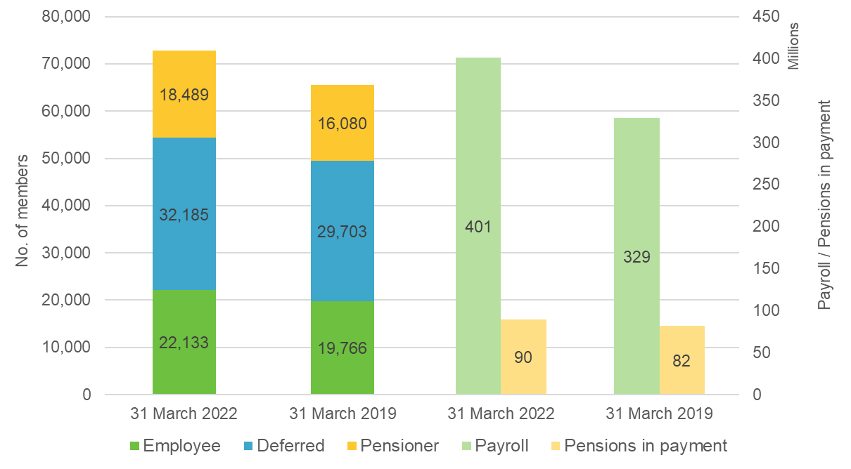
Membership data summary
High quality membership data

Slide 10
Assumptions
To set and agree assumptions for the valuation, the Administering Authority commissioned an assumption setting paper – ‘220531 Suffolk Pension Fund Assumptions paper’. The assumptions in this report were agreed by the Pensions Committee on 24 June 2022. The assumptions represent the ‘best estimate’ of future expectations – that means we estimate there is a 50% chance that future events will be better or worse than the assumption. The discount rate is the exception, as it includes the margin of prudence required by the LGPS Regulations.
Financial assumptions
Summary of assumptions used for measuring the funding level, compared to last valuation on 31 March 2019
Assumption | 31 March 2022 | Required for | 31 March 2019
Discount rate | 3.7% pa | To place a present value on all the benefits promised to scheme members at the valuation date. The Fund’s assets are estimated to have a 80% likelihood of returning above the respective discount rate at each valuation date. | 3.5% pa
Benefit increases/CARE revaluation | 2.7% pa | To determine the size of future benefit payments. | 2.3% pa
Salary increases | 3.7% pa | To determine the size of future final-salary linked benefit payments. | 3.0% pa

Slide 11
Inflation expectations
APPENDIX 3
Current inflation is significantly above the Bank of England target (2% pa) and recent norms. It is likely this will mean a high 2023 pension increase (based on September 2022 CPI inflation).
Current expectations are that inflation pressures will be short-term and move back to normal in the longer-term. The inflation assumption we have used reflects this pattern and allows for the short-term spike – see the blue line on the chart.
The assumption noted in this report is an average of the blue line over the approximate duration of the Fund’s liabilities.
Increased uncertainty and risk
There is a lot of uncertainty around both the level of future short-term inflation and how long the period of higher inflation will last. We will continue to work with the Fund to monitor actual and future expected inflation as more information emerges.
March 2019 projection
March 2022 projection
Chart shows median expected annual CPI inflation from ESS model.

Slide 12
Assumptions
    Other demographic assumptions
Death in service | See sample rates in Appendix 2
Retirements in ill health | See sample rates in Appendix 2
Withdrawals | See sample rates in Appendix 2
Promotional salary increases | See sample rates in Appendix 2
Commutation | 55% of future retirements elect to exchange pension for additional tax free cash up to HMRC limits
50:50 option | 0.7% of members (uniformly distributed across the age, service and salary range) will choose the 50:50 option
Retirement age | The earliest age at which a member can retire with their benefits unreduced
Family details | A varying proportion of members are assumed to have a dependant at retirement or on earlier death. For example, at age 60 this is assumed to be 90% for males and 85% for females. The dependant of a male member is assumed to be 3 years younger than him and the dependent of a female member is assumed to be 3 years older than her.
Demographic assumptions
Longevity
Whole fund average life expectancies from age 65, with 2019 comparison.
 | 31 March 2022 | 31 March 2019
Male pensioner | 22.0 years | 21.9 years
Male non-pensioner | 22.7 years | 22.7 years
Female pensioner | 24.6 years | 24.1 years
Female non-pensioner | 26.2 years | 25.6 years
Pensioners are assumed to be aged 65 at the respective valuation date and non-pensioners are assumed to be aged 45.
Further information on these assumptions can be provided upon request.

Slide 13
Fund-level results

Slide 14
Funding position as at 31 March 2022
Valuation Date | 31 March 2022 | 31 March 2019
Past Service Liabilities | (£m) | (£m)
Employees | 1,213 | 963
Deferred Pensioners | 809 | 649
Pensioners | 1,500 | 1,354
Total Liabilities | 3,522 | 2,966
Assets | 3,755 | 2,931
Surplus/(Deficit) | 233 | (35)
Funding Level | 107% | 99%
The funding level and surplus/deficit figures provide a high-level snapshot of the funding position on 31 March 2022. There are limitations:
The liabilities are calculated using a single set of assumptions about the future, so are sensitive to the choice of assumptions.
The market value of assets changes daily

Slide 15
Changes since the last valuation
Future expectations
Factor | What does it affect?​ | What's changed? | Impact on liabilities
Future investment returns | The rate at which future benefit payments are discounted back, ie the discount rate assumption​ | Future investment returns slightly higher at 2022 than at 2019. The required return is now 3.7% pa vs. 3.5% pa at 2019. | Decrease of £111m
Inflation | The rate at which pensions in payment and deferment and CARE pots increase​ | Significant increase in short-term future inflation expectations. | Increase of £259m
Salary increases | The rate at which future salaries increase. This affects benefits that are still linked to final salary, ie accrued before 1 April 2014​ | No material change since last valuation given competing factors e.g. tighter budgetary conditions vs. strong job market and pressure from National Living Wage increases. | Increase of £9m
Current life expectancy | How long we expect people to live for based on today’s current observed mortality rates.​ | Slight reduction in life expectancy based on current observed data (not allowing for Covid-related excess deaths) | Decrease of £14m
Future improvements in life expectancy | How we expect life expectancies to change (increase) in the future.​ | Uncertainty about effectiveness of mitigations against life expectancy increases in the LGPS i.e. State Pension Age increases and Cost Cap. Need to better reflect wider pension and insurance industry long-term expectations. | Increase of £22m

Slide 16
Reconciling the overall change in funding position
The tables below provide insight into the funding position changes between 31 March 2019 and 31 March 2022. Firstly, the changes we expect to happen, which relate mostly to items on the asset side. Then the impact of actual experience, which mainly affects the liabilities.
Impact of actual events
Change in the surplus/deficit position | Assets | Liabilities | Surplus / Deficit
 | £m | £m | £m
Expected position at 31 March 2022 | 3,292 | 3,354 | (62)
Events between 2019 and 2022
Salary increases greater than expected | 0 | 25 | (25)
Benefit increases greater than expected | 0 | (44) | 44
Early retirement strain (and contributions) | 7 | 3 | 5
Ill health retirement strain | 0 | (6) | 6
Early leavers less than expected | 0 | (3) | 3
Commutation less than expected | 0 | 0 | 0
McCloud remedy | 0 | 2 | (2)
Other membership experience | 0 | 63 | (63)
Higher than expected investment returns | 456 | 0 | 456
Changes in future expectations
Investment returns | 0 | (111) | 111
Inflation | 0 | 259 | (259)
Salary increases | 0 | 9 | (9)
Longevity | 0 | 8 | (8)
Other demographic assumptions | 0 | (37) | 37
Actual position at 31 March 2022 | 3,755 | 3,522 | 233
Expected development
Change in the surplus/deficit position | Assets | Liabilities | Surplus / Deficit
 | £m | £m | £m
Last valuation at 31 March 2019 | 2,931 | 2,966 | (35)
Cashflows
Employer contributions paid in | 287 | 0 | 287
Employee contributions paid in | 71 | 0 | 71
Benefits paid out | (309) | (309) | 0
Other cashflows (e.g. Fund expenses, net transfers*) | (3) | 0 | (3)
Expected changes
Expected investment returns | 315 | 0 | 315
Interest on benefits already accrued | 0 | 327 | (327)
Accrual of new benefits | 0 | 370 | (370)
Expected position at 31 March 2022 | 3,292 | 3,354 | (62)
* We have insufficient data to value the impact on the liabilities as a result of transfers in/out

Slide 17
Initial employer results

Slide 18
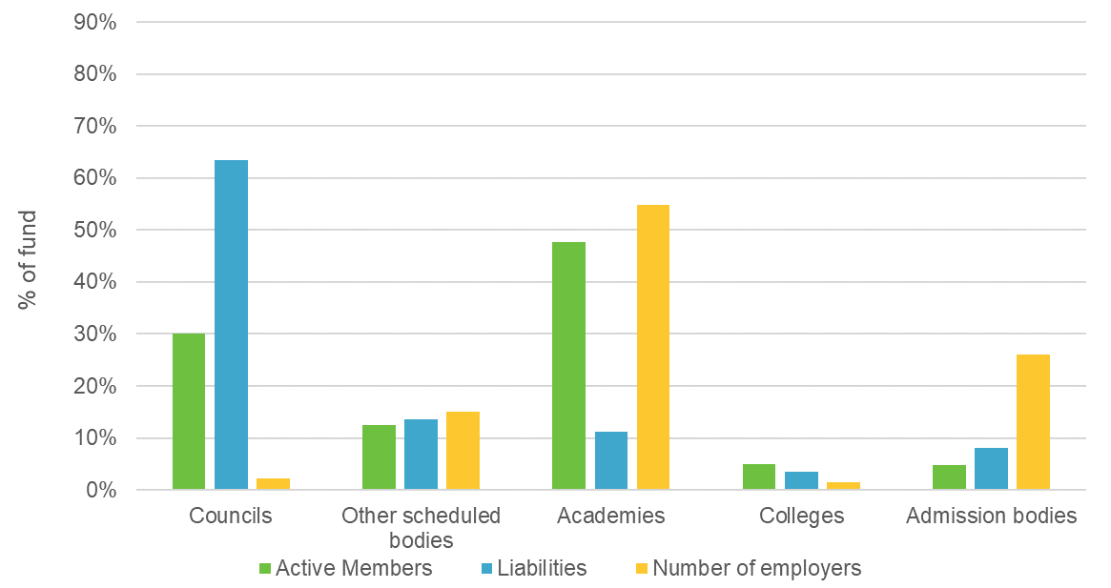





Focusing on employers
Whole-fund level results give a important overview of the Fund’s health but are not the valuation’s most important output.
Fund employers by type
The Fund is funded at individual employer level. Each employer (or pooled group of employers) is responsible for funding the benefits earned by their current and ex-staff.
The next stage of the valuation has been preparing funding positions and reviewing contribution rates for each employer in the Fund. There is a significant range and diversity of employers, so we work with the Fund to make sure the funding strategy recognises this diversity and is flexible enough to cater for employers’ differences.
The funding strategy statement is issued out for consultation alongside the employer level valuation results.
Ensure funding plan is appropriate for each employer

Slide 19
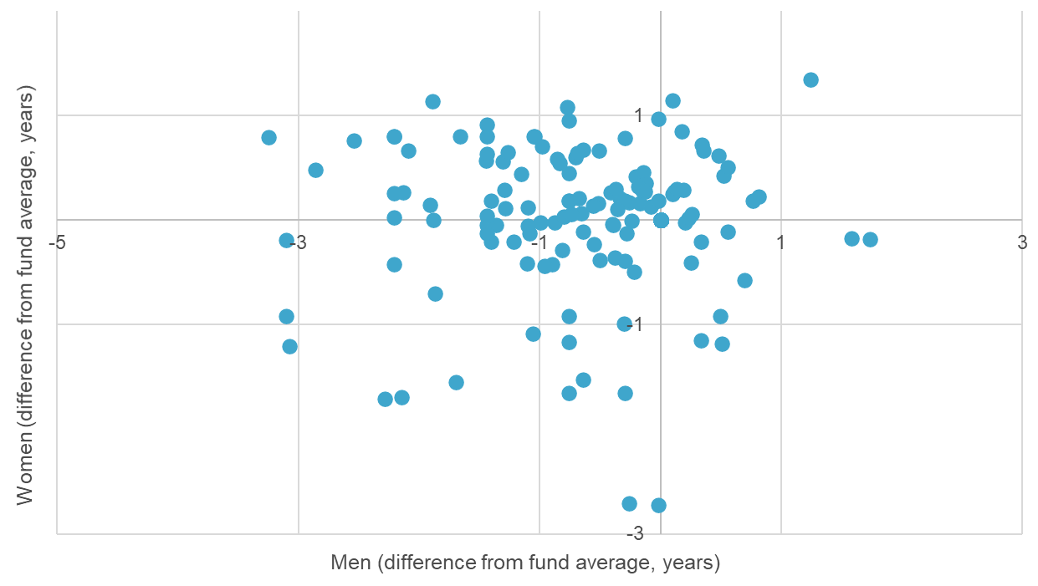
Capturing the diversity in funding calculations
Employer diversity is not restricted to type and size – even for smaller employers, there are significant differences in funding positions and contribution rates. This may be due to previous decisions, for example early retirement experience, pay awards, level of contributions paid, or because the membership varies.
Life expectancy is a good example of the diversity of membership. Studies show it can vary between members due to factors like socio-economic status and retirement health. Using Club Vita to set a baseline life expectancy assumption captures this individual member variation. That means the liabilities and contribution rates better reflect the Fund’s, and each employer’s, membership.
    Difference in average life expectancy (from fund average) at employer level
Most employers are grouped around a central cluster; outliers will have a relatively larger proportion of members in higher/lower socio-economic groups.
Results are based on initial draft employer results. These may change during the employer results preparation stage of the valuation.

Slide 20
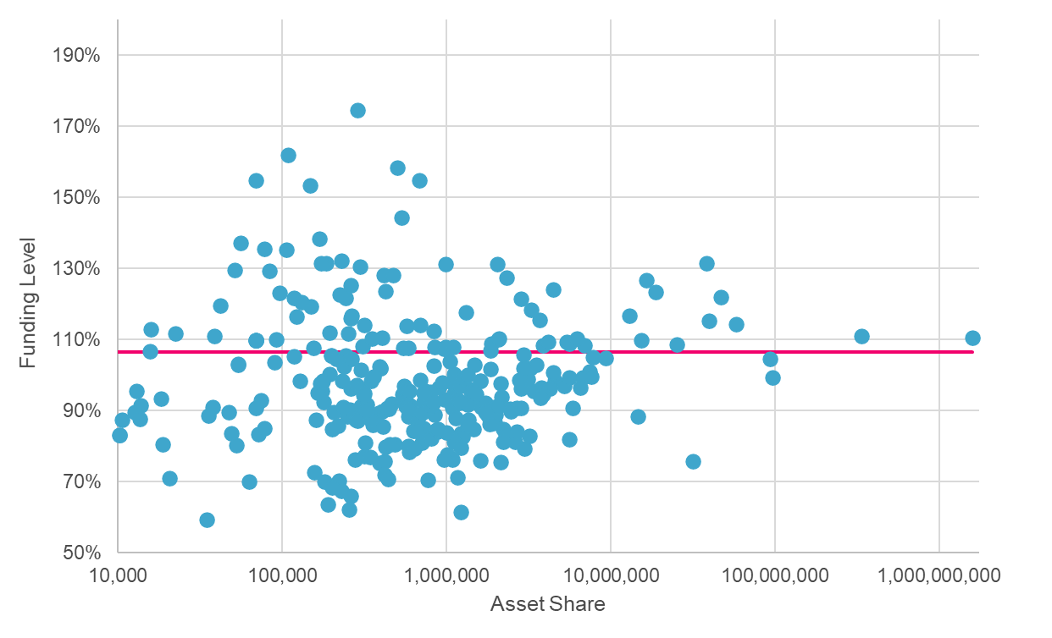
Individual employer funding levels
The Fund is composed of over 300 employers with active members. Each employer (or pooled group of employers) has its own funding position and contribution plan. The Fund’s overall funding position is the combination of all these employers’ results.
    Employer funding level vs asset share
This chart shows the range of employer funding positions. Each dot represents an employer and shows:
The employer’s share of the Fund assets, horizontal scale (NB this is a logarithmic scale, to accommodate the great range in size of employer from smallest to largest).
The employer’s funding level on 31 March 2022, vertical scale.
The red line is the Fund’s overall funding level and shows that it does not relate to the average of the employer results. Instead, the whole Fund position is driven by the largest employers (right-hand side of the chart).
This shows the importance of considering individual employer results as well as the whole Fund position.
Results are based on initial draft employer results. These may change during the employer results preparation stage of the valuation.

Slide 21
Looking to the future
Managers
Liabilities
Assets
Benefits earned in future
Future
investment
returns
Contribution rates
  To pay for both future benefits and any shortfall in relation to accrued benefits
  Strike a balance between investment returns and contribution rates
Future contributions
Funding level
  Comparison of ‘assets today’ vs. ‘benefits earned to date’
  Balance sheet snapshot of Fund at valuation date
t=0
Benefits earned to date
Assets today

Slide 22
Next steps

Slide 23
Next steps
1
2
3
    Individual employer/group valuation results (and Funding Strategy Statement) issued to employers.
    Employer consultation period
    Sign off valuation report including contribution rates for all Fund employers
    End Feb 2023

Slide 24
Appendices

Slide 25
Reliances and limitations
APPENDIX 1
We have been commissioned by Suffolk County Council (“the Administering Authority”) to carry out a full actuarial valuation of the Suffolk Pension Fund (“the Fund”) as at 31 March 2022 as required under Regulation 62 of the Local Government Pension Scheme Regulations 2013 (“the Regulations”).
This information can be used by the Administering Authority to support the development of the funding strategy and to identify and understand areas of potential risk that it may wish to explore or mitigate during the valuation process.
Technical Actuarial Standards apply to this advice, and have been complied with where material and to a proportionate degree. They are:
TAS100; and
TAS300.
Note that this report does not comply with paragraphs 12 (b) or (c) of TAS 300, regarding future projections of funding level and its volatility. The figures in this report provide a notification of the whole Fund funding position, rather than individual employer positions. Therefore, we do not believe the exclusion of the information under these paragraphs is material.
This paper is addressed to the Administering Authority. It has been prepared by us as actuaries to the Fund and is solely for the purpose of:
presenting the current funding position; and
explaining why the funding position has changed since the previous valuation in 2019
It has not been prepared for any other purpose and should not be used for any other purpose.
The Administering Authority is the only user of this advice. Neither we nor Hymans Robertson LLP accept any liability to any party other than the Administering Authority unless we have expressly accepted such liability in writing. The advice or any part of it must not be disclosed or released in any medium to any other third party without our prior written consent. In circumstances where disclosure is permitted, the advice may only be released or otherwise disclosed in its entirety fully disclosing the basis upon which it has been produced (including any and all limitations, caveats or qualifications).
© Hymans Robertson LLP October 2022

